Slide 1


React Native
Järvinen Viivi
Laajala Riku
Niiranen Topi
Rohunen Jenni

Slide 2
React Native is the future

Slide 3










Thousands of apps are using React Native
Notes:
Facebook, Instagram, AirBnb, Tesla, Skype, SoundCloud etc…

Slide 4
What is it?
Open source project started by Facebook
Build cross-platform native mobile apps using JavaScript.
Works very similarly to React
which is JavaScript library for building single page web applications.
Uses the same fundamental UI building blocks as regular iOS and Android apps.

Slide 5
Components
When you're building a React Native app, you'll be making new components
Dividing the application's structure into small components eases maintenance and testing
Component requires a render function which returns some JSX to render

Slide 6
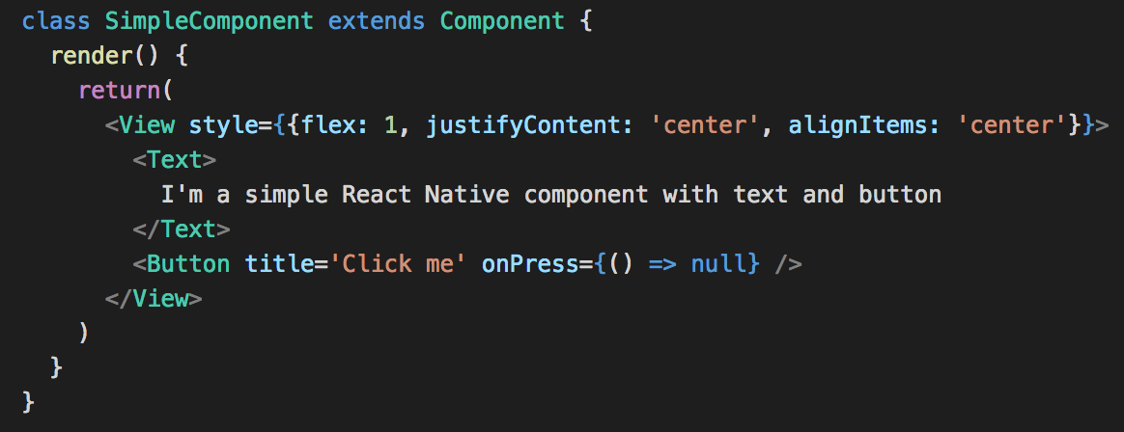
Creating a simple component

Slide 7
Props
Creation parameters witch are used to customize components while created.
Fixed throughout the lifetime of a component

Slide 8
State
Parameters inside the components
For data that needs to be changed
Initialized in the constructor
setState() is a method to make changes to components state

Slide 9
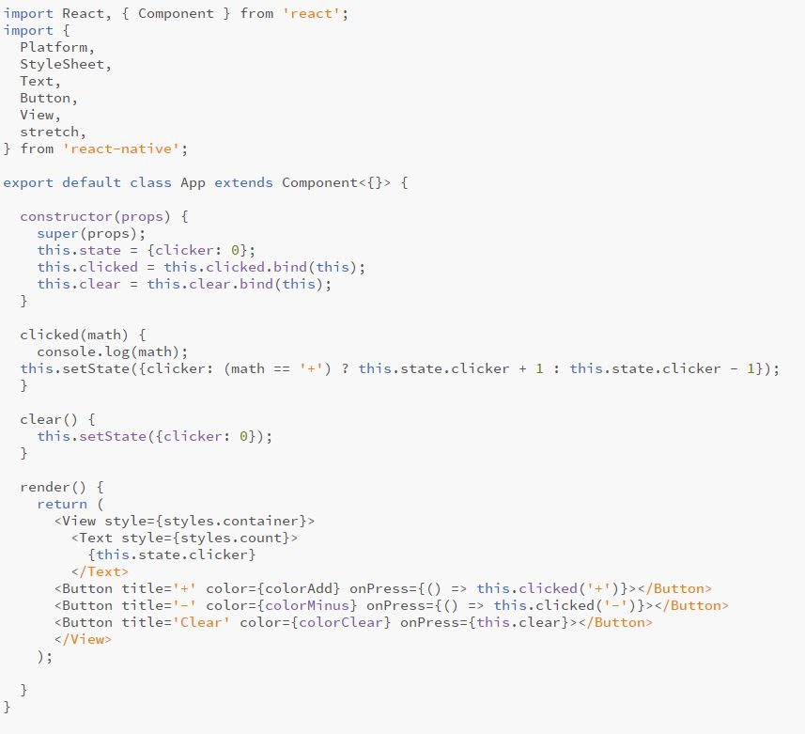
Component state demo

Slide 10
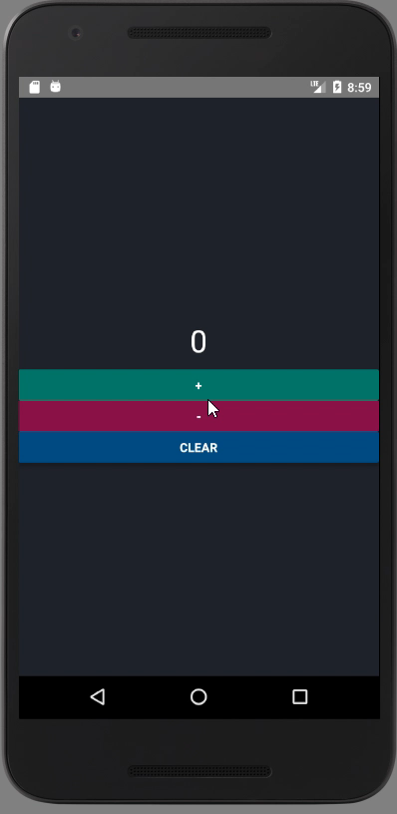
Component state demo
https://github.com/k2346/MobileAppHarkkatyoDemo

Slide 11
Styling with React Native
To style your components, you will have to create stylesheets in Javascript.
Styling looks similar to CSS, except names are written using camel casing.
Example: background-color is written backgroundColor
React-Native is not made from web elements and can’t be styled in the same way.

Slide 12
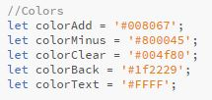
Styling with React Native
You can specify layout using flexbox
Styles are defined through code
Take advantage of this, and add code into your styles definition.
Notes:
EXEPTION! Button does not have a style prop so you cannot do much to it with styiling. If you dont like that you can build your own button component.

Slide 13
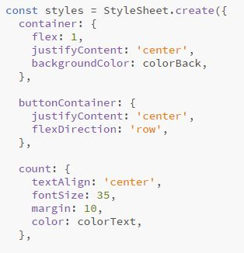
StyleSheet.Create
As a component grows in complexity, it is often cleaner to use StyleSheet.create to define several styles in one place.
Notes:
EXEPTION! Button does not have a style prop so you cannot do much to it with styiling. If you dont like that you can build your own button component.

Slide 14
Navigation
React Native doesn't offer any built in navigation.
Different libraries available for use:
React-Navigation
NavigatorIOS
Native-Navigation
React-Native-Navigation
...and probably more

Slide 15
React-Navigation
Community made, standalone JavaScript library for adding navigation in your application
Easy, straightforward setup
Flexible, configurable. Can be intergrated with state management libraries like such as redux

Slide 16
Navigators
With navigators you can define your applications navigation structure.
Navigators also render common elements such as headers and tab bars which you can also configure yourself

Slide 17
Navigators
React-Navigator includes three different type of navigators:
StackNavigator
=> Screens are stacked on top of eachother
TabNavigator
=> Shows tab bar with selectable tabs in top or bottom of the screen
DrawerNavigator
=> Navigator which slides in from either left or right side of the screen

Slide 18
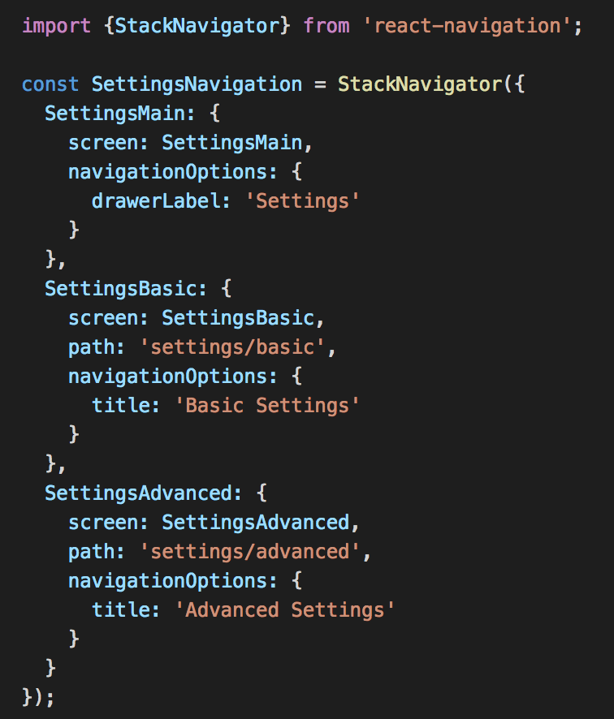
Creating a StackNavigator

Slide 19
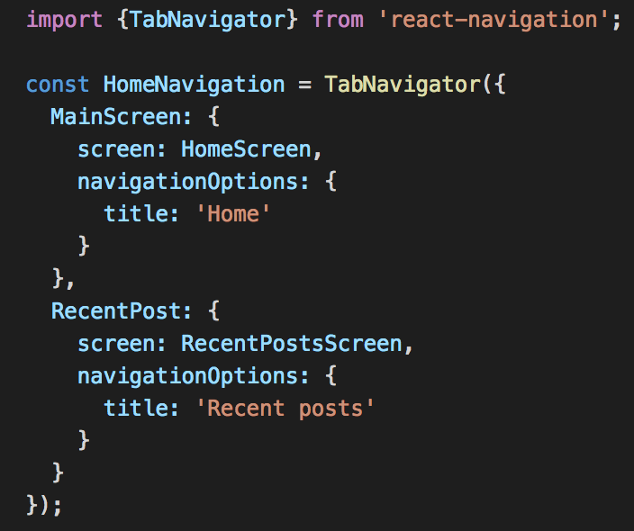
Creating a TabNavigator

Slide 20
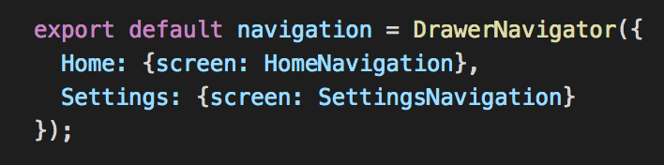
Nesting navigators
Navigators can also be nested, so it's possible to compose pretty complex navigation structure for your application

Slide 21
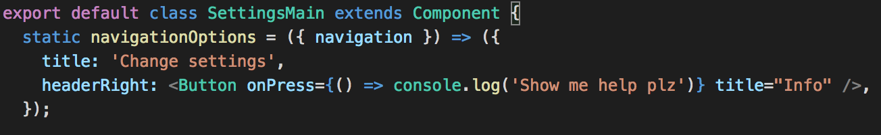
Configuring the Header
Header is only available for StackNavigator
You can configure header when creating the navigator or later if you need to modify it based on incoming data, user input, etc

Slide 22
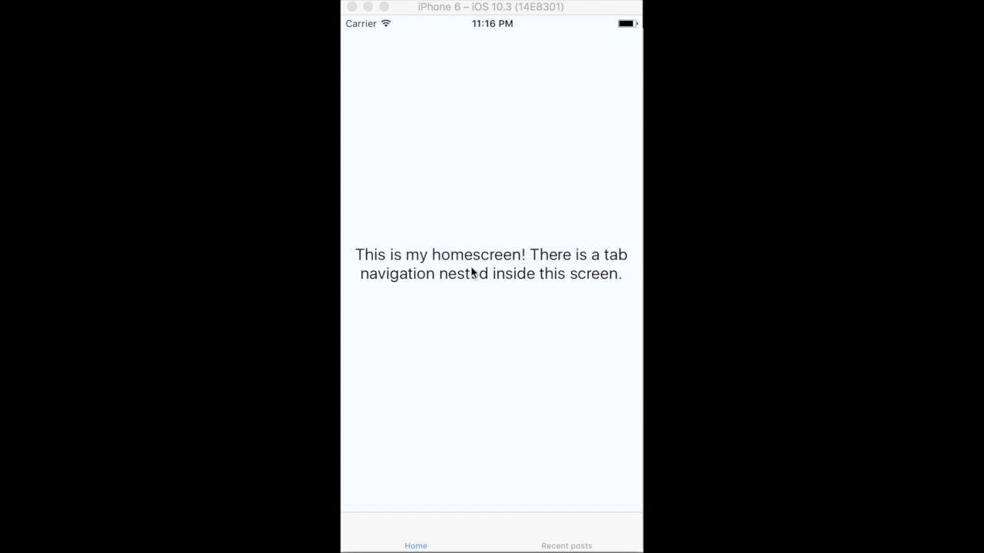
Navigation demo
https://github.com/rikulaa/react-native-test

Slide 23
Geolocation
The Geolocation obtains the position of the device.
It gives Web content access to the location of the device.
On iOS devices it’s on by default
On Android devices you have to edit AndroidManifest.xml: <uses-permission android:name="android.permission.ACCESS_FINE_LOCATION" />

Slide 24
Geolocation
getCurrentPosition allows to request a user’s location at any time.
enableHighAccuracy - which allows you to get the most accurate location.
timeout - how long does the API have to return the position before throwing an error.
maximumAge - if a location exists in the device cache, how old can it be before it’s no longer valuable to your app.

Slide 25
Geolocation
watchPosition is very similar to getCurrentPosition. The only difference is that the success or error callback will be called whenever the user’s location updates.
clearWatch should be used any time watchPosition is used. This will tell the device that your app no longer needs location information.

Slide 26
Geolocation
watchPosition is very similar to getCurrentPosition. The only difference is that the success or error callback will be called whenever the user’s location updates.
clearWatch should be used any time watchPosition is used. This will tell the device that your app no longer needs location information.

Slide 27
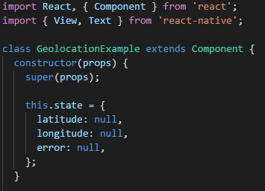
Geolocation example

Slide 28
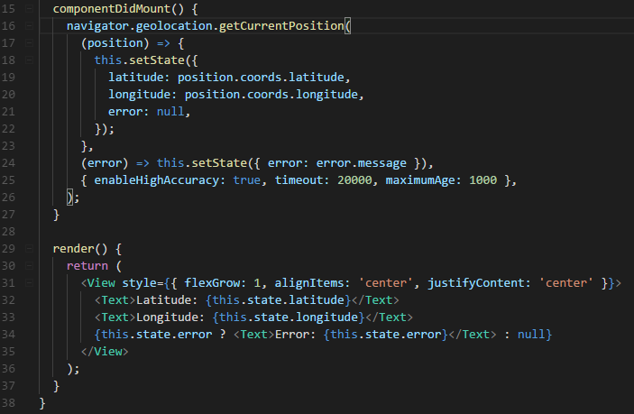
Geolocation example

Slide 29
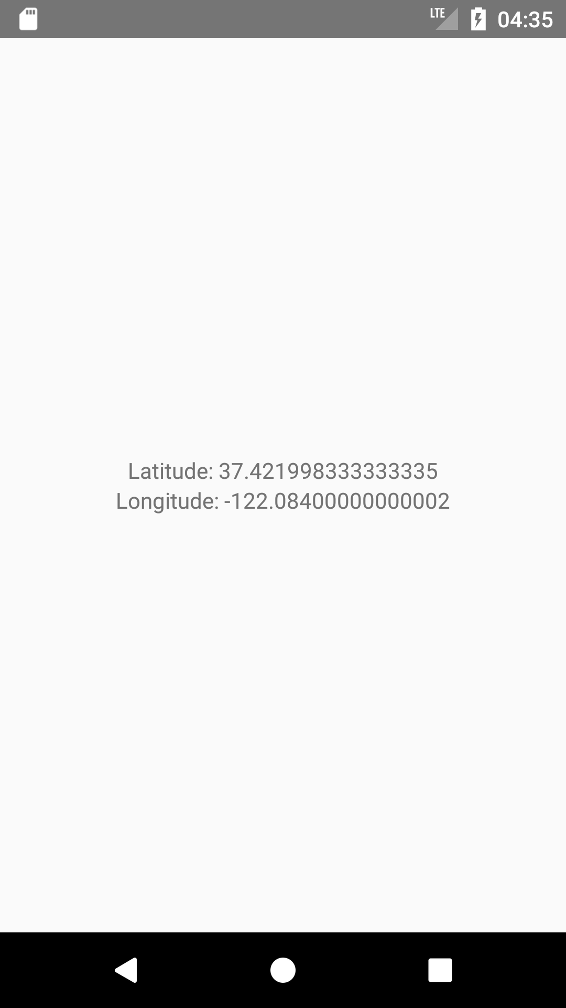
Geolocation example

Slide 30
Questions?

